Slide 1
PROJECT NAME:-
EMAIL SPAM DETECTION
SUBMITTED BY:
SHIVAM SHARMA

Slide 2
INTRODUCTION
Problem Statement :
Spam Detector is used to detect unwanted, malicious and virus infected texts and helps to separate them from the non spam texts. It uses a binary type of classification containing
the labels such as ‘ham’ (nonspam) and spam. Application of this can be seen in Google Mail(GMAIL) where it segregates the spam emails in order to prevent them from getting into
the user’s inbox.
The files contain one message per line. Each line is composed by two columns: v1 contains the label (ham or spam) and v2 contains the raw text.
A collection of 5573 rows SMS spam messages was manually extracted from the Grumbletext Web site. This is a UK forum in which cell phone users make public claims about SMS spam messages, most of them without reporting the very spam message received. The identification of the text of spam messages in the claims is a very hard and time-consuming task, and it involved carefully scanning hundreds of web pages.

Slide 3
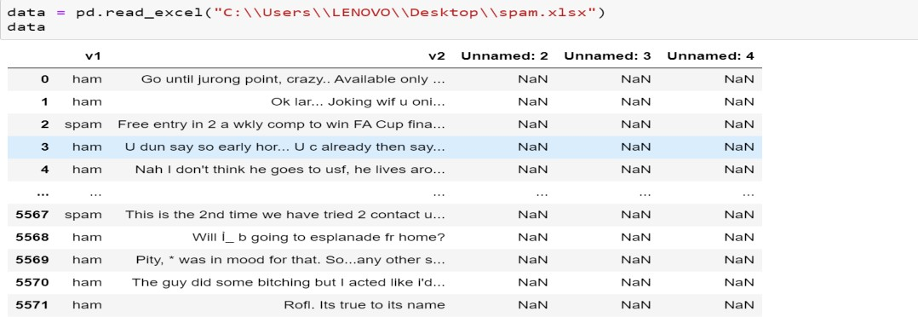
Review of Literature
The topic is about to build a Model which can predict the LABELS(‘ham’ or ‘spam’) of any email by analysing the message inside it.
Motivation for the Problem Undertaken
As the frauds increasing day by day due to increment in the technology rapidly, So that is very necessary to avoid the frauds that’s y it is very necessary to avoid spams from the messages or from emails so that we can prevent someone from the frauds.
Data Sources and their format
Grumbletext Web site
NUS SMS Corpus (NSC)
The dataset import from the excel sheet

Slide 4
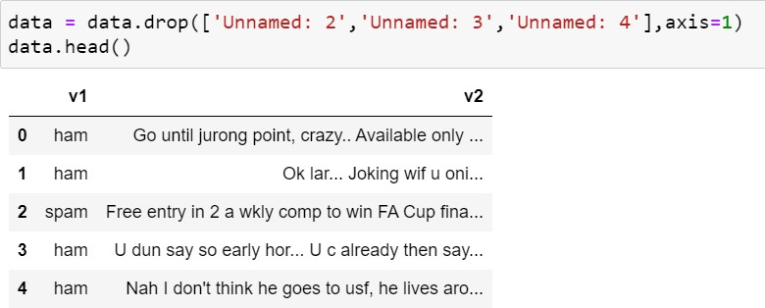
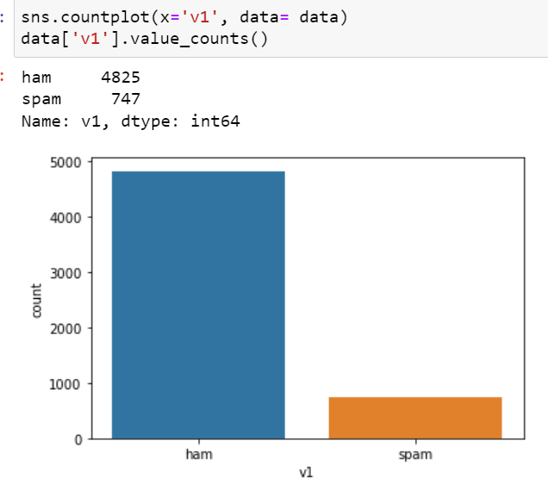
Data Preprocessing and EDA
The steps followed for the cleaning and EDA of the data:-
First we analyse the data by simply data.info() and data.describe() methods so that we can check about the datatypes and checked themean , median and deviation.
Then we drop some unwanted columns by drop method.
3) Then we checked the counts of spam and hams in the datset by the help of the countplot.

Slide 5
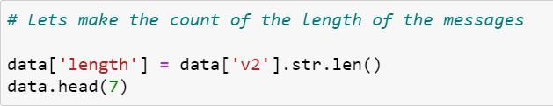
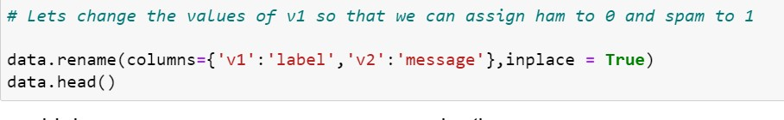

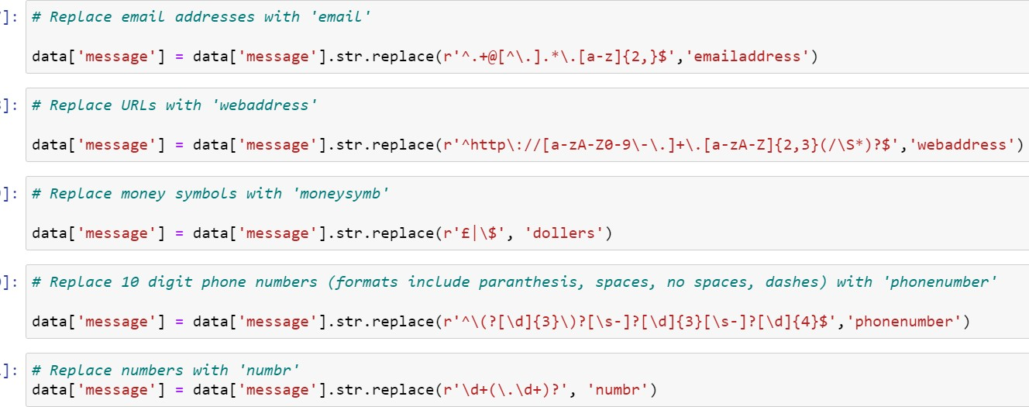
4) Then after we made a new Column of Length which contains the totallength of the message.
5) After that we rename the name of the columns as we give our output to Label and to feature as message.
6) And also assign the value 0(ham) , 1(spam) from the column of label .
7) Then after we Convert all messages in lower case, we replaced email addresses with 'email', URLs with 'webaddress’, money symbols with 'moneysymb' (£ can by typed with ALT key + 156), 10 digit phone numbers (formats include paranthesis, spaces, no spaces, dashes) with 'phonenumber', and numbers with
'numbr'…

Slide 6
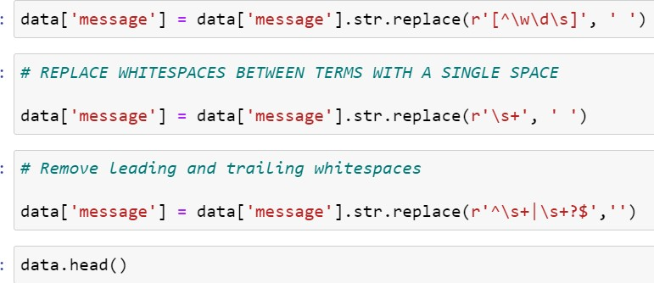
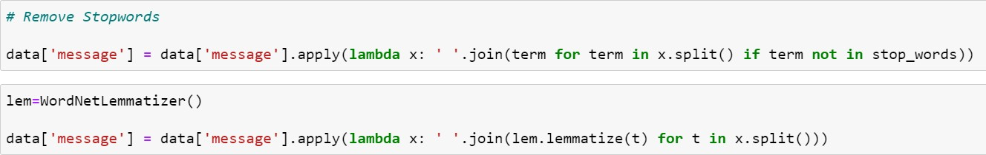
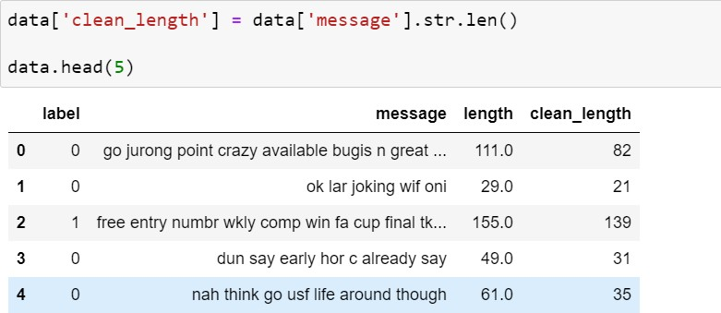
8) Then after we apply lambda function to remove the Stopwords and punctuations from the comment and then we used
WordNetLemmatizer so that we can make Lemmas and words can bereduced into their meaningful roots..
9) Then after lemmatizing the comment we made a new column(name as Clear_lenght) so that we can check the original nad clear length separately by doing these cleanings(like
stopwords, punctuations andmany more as written above)..

Slide 7
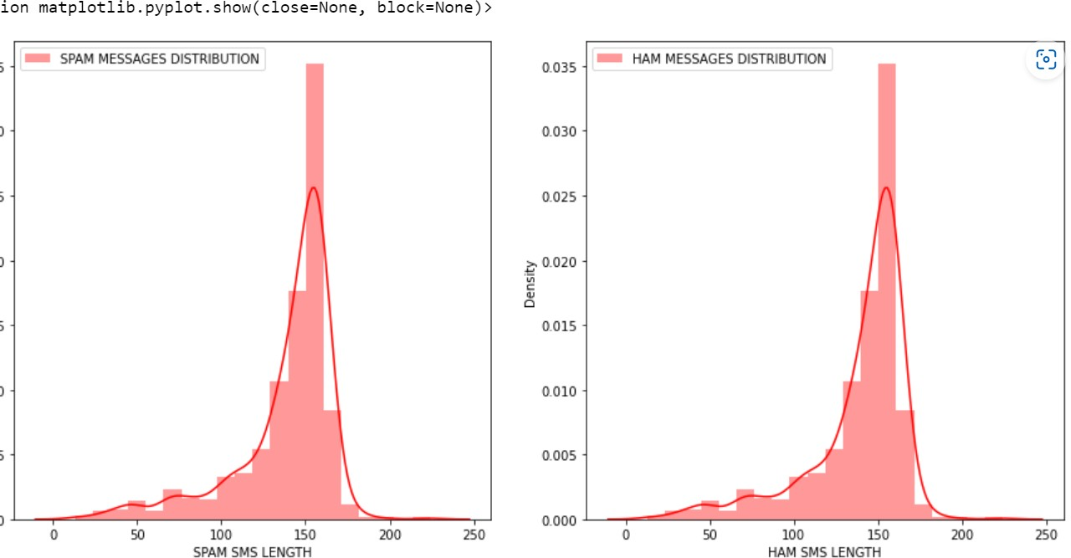
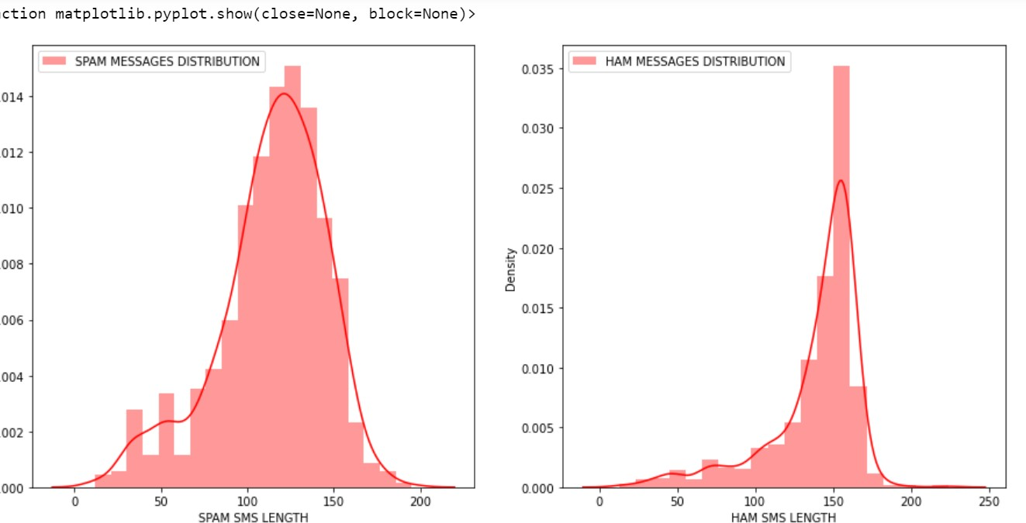
10) By the help of matplot and seaborn we plot some graph before and after cleaning the distribution of the messages .
BEFORE CLEANING:-
AFTER CLEANING:

Slide 8
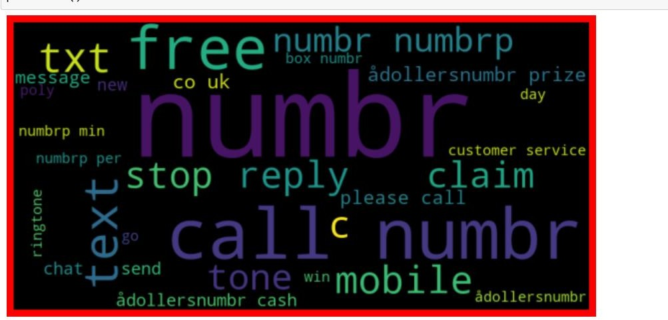
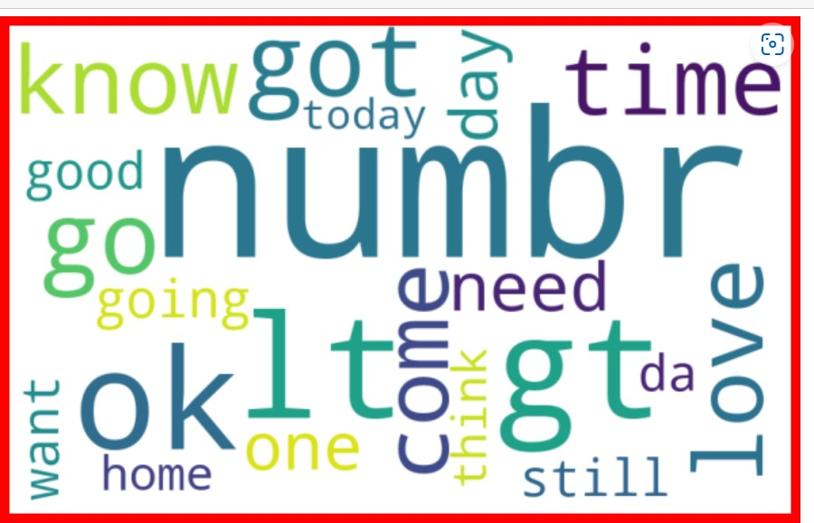
11) Then we used wordcloud for some words that are Loud so that our modle predict on the basis of these words.
FOR SPAM:
FOR HAMS:

Slide 9
Then after this we are ready to convert the messages into the Vector form (as machine can not understand object/strings) with
thehelp of TF-IDF Vectorizer…
Now we are ready for the model building..
Algorithm used in this project:-
For building machine learning models there are several models present inside the Sklearn module.
Sklearn provides two types of models i.e. regression and
classification. Our dataset’s target variable is to predict whether fraud is reported or not. So for this kind of problem we use
classification models.
But before the model fitting we have to seprate the predictor and target variable, then we pass this variable to the
train_test_split method
to create the training set and testing
setfor the model training and prediction.
We can build as many models as we want to compare the accuracy given by these models and to select the best model among them.
I have selected 5 models:

Slide 10
1. MultinomialNB
Logistic Regression
Decision Tree Classifier
Random forest Classifier
Gradient boosting Classifier
BEST Algo. From these And why?
Random Forest classifier is the best algo. From all of these algorithms which is used in this data to predict because the difference between the cross val score and the accuracy score is minimum for the Random Forest algo. and it also gives BETTER ACCURACY(approx. 99.7%)that’s why we USED THISAlgo.
Then we hypertune this algo with the help of Grid searchCV .
Save the model for later predictions
# Now my model is ready to predict

Slide 11
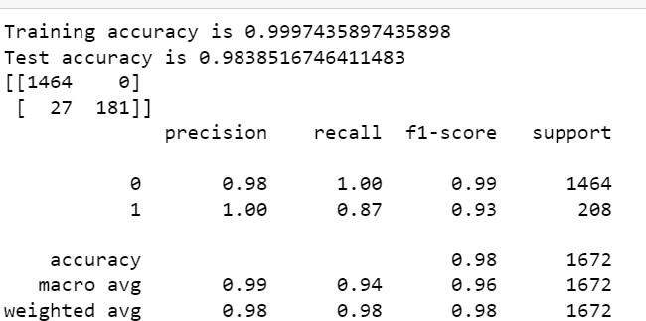
CONCLUSIONS
So these are the classification report results of the Random algo.
Hence my model is ready to predict….

